Slide 1














CUSTOMER CHURN ANALYSIS AND RECOMMENDATIONS
CUSTOMER CHURN ANALYSIS AND RECOMMENDATIONS
Student Name:
Student ID:
Module: Digital Business: Models, Marketing and Operations
Date:
Notes:
Welcome to everyone so now I will be presenting the key insights from our customer churn analysis and also provide all the recommendations to help improve retention.

Slide 2

INTRODUCTION
The major results that are found while analyzing customer churn data with Tableau it is learnt that the factors cause customers to leave (Guliyev and Yerdelen Tatoğlu, 2021).
The connection between digital tools and company sections are studied.
The role in reducing customers leaving, engaging with them and addressing privacy and security concerns are also explained.
Notes:
Using Tableau, we studied customer churn data to learn about the reasons why people leave and how to make them stay. In this message, I summarize what we found and recommend digital tools and roles to help keep your customers and manage concerns about their privacy.

Slide 3

KEY FINDING 1 — DATA PLAN AND CHURN RATES
The analysis found that those using 5-10 GB a month have the highest churn rate at about 32%, while 10+ GB users come next at 27% and those using less than 5 GB have the smallest churn rate at about 23%.
Those international plan customers who have not used their service in a while are more likely to cancel, at 71%, than customers who actively use the service, who face a much lower churn rate at 7.5%.
Thus, the number of data packs used and activation of international services influence how many customers stay with the company (Zhygalkevych et al., 2022).
Notes:
People who download 5-10 GB in a month are most likely to leave us, possibly because they are not satisfied with the data speed or amount. Users who are not active on their international plans change carriers much more frequently, while active international users rarely switch. It suggests that smaller changes in their plans might reduce the number of people leaving from these groups.

Slide 4
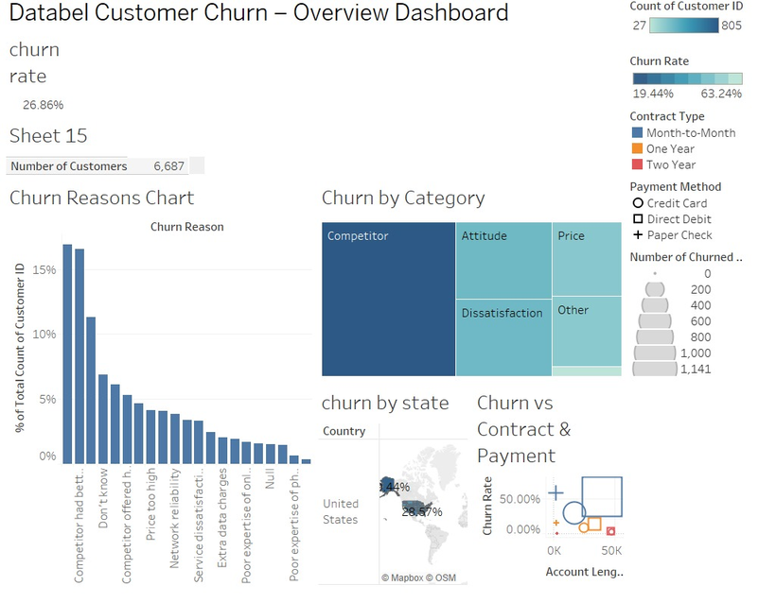
KEY FINDING 2 — CONTRACT TYPE AND PAYMENT METHOD
Those with one or two-year agreements tend to stay with the company longer than those who only have a month-to-month contract (Pejić Bach, Pivar and Jaković, 2021).
In addition, fewer direct debit customers churn than credit card customers which may be because paying by direct debit is simpler.
It is found that having flexible contracts and easy payment options plays a big role in stopping users from leaving.
Notes:
Customers who have month-to-month contracts tend to cancel more often than those who have one or two-year contracts. This proves that using longer contracts results in higher retention. Payment method also matters; People who use direct debit to pay are less likely to churn, shy away or cancel their accounts compared to those who use credit cards.

Slide 5
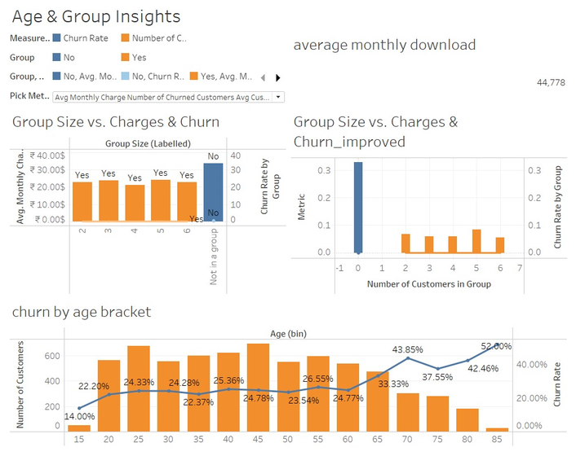
KEY FINDING 3 — AGE AND GROUP MEMBERSHIP IMPACT
The percent of customers leaving the service gets higher as they get older, rising to 52% among those who are 65 or older.
Seniors might be looking for different kinds of support or service.
Generally, customers who subscribe to group or bundle options tend to stick with a service longer than single subscribers do which shows the power of group-based packages in retaining customers (Steffen et al., 2019).
Notes:
Older customers are more likely to cancel, reaching over 50% in the 65+ age bracket. It is possible that older people need special assistance to enjoy your flights. Those who are part of group or bundle plans are generally less likely to leave when compared to those who buy on their own.

Slide 6
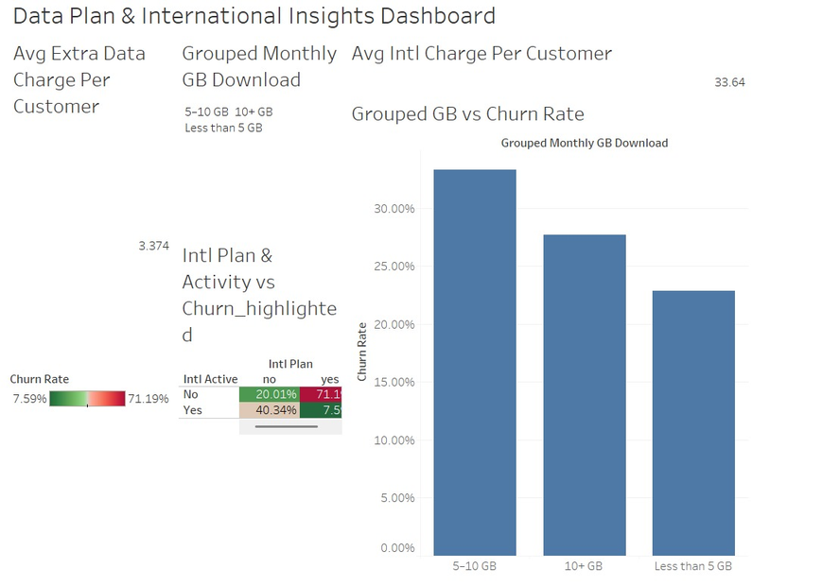
KEY FINDING 4 — REASONS FOR CHURN
According to customers, their key reasons for switching are that other brands give them better offers, they are worried about the brand’s pricing and their attitude toward customers.
Non-reliable networks and poor services also play a big role.
They show that companies should watch the pricing plans of competitors and aim to make their service better to maintain customers (Nagle, Müller and Gruyaert, 2023).
Notes:
Customers stated that they would churn if the prices were better elsewhere, if they felt dissatisfied with what they were offered or if they sensed poor customer attitude. Issues with network reliability and customer dissatisfaction with service play a smaller role as well. Working on these causes helps cut down the rate of customers leaving.

Slide 7
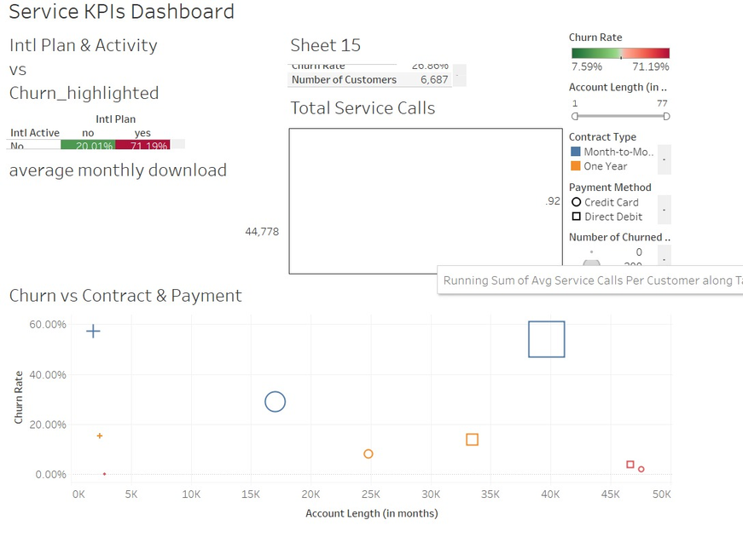
KEY FINDING 5 — SERVICE KPIS AND ACCOUNT LENGTH
Customers are more likely to make a number of service calls as per their churn rate goes up.
Moreover, those who stay with a company for a longer period of time generally stay loyal, as shown by the lower churn rates.
These ideas point for the better customer service and also encouraging loyalty to help stop customer churn (Devriendt, Berrevoets and Verbeke, 2019).
Notes:
Those who cancel their contracts quickly contact customer service more often, especially when they are on month-to-month contracts. Generally, customers who stick with a company for longer do so mainly because the service is still high quality.

Slide 8
RECOMMENDATIONS — LEVERAGING DIGITAL TOOLS
Using both CRM and analytics together allows a company to foresee potential problems with its customers and take the appropriate actions.
Tailored marketing and loyalty schemes delivered online will boost how customers feel about a business.
Promotions based on how a customer uses the service will motivate them to stick with the brand (Bahari and Basalamah, 2020).
Notes:
Using CRM together with predictive analytics can help you catch customers who may quit early. Offering personalized marketing and loyalty benefits on digital platforms helps engage customers and make them more satisfied. For example, incentives provided based on customer habits encourage them to stay.

Slide 9
RECOMMENDATIONS — DEPARTMENTAL COLLABORATION
The IT team who needs to work on strong data systems and also make analytics support available.
Marketers must create the targeted advertising which is guided by what they know about the customers.
Training customer service teams in how to communicate well and also to solve issues should be a priority for HR departments.
It is necessary for the marketing, sales and PR departments to cooperate to carry out retention strategies properly (Czinkota et al., 2021).
Notes:
Successful implementation requires the cross-department collaboration. The reliable infrastructure and also analysis tools are necessary from the IT side. Marketing strategies should be customized by using data from analytics. HR ought to concentrate on teaching to customer service teams how to tackle concerns, by making the customer service better and also decreasing customer attrition.

Slide 10

RECOMMENDATIONS — PRIVACY AND SECURITY CONSIDERATIONS
Securing customer data with encryption and complying with data protection laws is very important.
When companies are open about their use of data and ask for consent, customers trust their actions.
Making it a priority to quickly respond to breaches and update affected customers will help reduce loss of customers worried about privacy (Ou et al., 2022).
Notes:
It is also important for the company to protect customer data against privacy and security risks. For this, companies should use tough encryption, stick to regulations concerning personal information and explain clearly how they use consumers’ data. Being ready to respond to data breaches helps keep customers trusting the business and lowers the risk of customers leaving.

Slide 11
REFERENCES
Bahari, A.F. and Basalamah, J. (2020). Attributes and Characteristics of Ad Spots: An Analysis of Motivation and Brand Loyalty. Jurnal Manajemen Bisnis, [online] 7(2), pp.91–101. Available at: https://jurnal.fe.umi.ac.id/index.php/JMB/article/view/439.
Czinkota, M.R., Kotabe, M., Vrontis, D. and Shams, S.M.R. (2021). Direct Marketing, Sales Promotion, and Public Relations. Springer Texts in Business and Economics, pp.607–647. doi: https://doi.org/10.1007/978-3-030-66916-4_13.
Devriendt, F., Berrevoets, J. and Verbeke, W. (2019). Why you should stop predicting customer churn and start using uplift models. Information Sciences, 548. doi: https://doi.org/10.1016/j.ins.2019.12.075.
Guliyev, H. and Yerdelen Tatoğlu, F. (2021). Customer churn analysis in banking sector: Evidence from explainable machine learning model. Journal of Applied Microeconometrics, [online] 1(2). Available at: https://avesis.istanbul.edu.tr/yayin/3b00284d-af04-419d-9906-a010407a0b76/customer-churn-analysis-in-banking-sector-evidence-from-explainable-machine-learning-model.
Nagle, T.T., Müller, G. and Gruyaert, E. (2023). The Strategy and Tactics of Pricing. [online] Routledge. doi: https://doi.org/10.4324/9781003179566.
Ou, C.X., Zhang, X., Angelopoulos, S., Davison, R.M. and Janse, N. (2022). Security breaches and organization response strategy: Exploring consumers’ threat and coping appraisals. International Journal of Information Management, [online] 65, p.102498. Available at: https://www.sciencedirect.com/science/article/abs/pii/S0268401222000299.

Slide 12
REFERENCES
Pejić Bach, M., Pivar, J. and Jaković, B. (2021). Churn Management in Telecommunications: Hybrid Approach Using Cluster Analysis and Decision Trees. Journal of Risk and Financial Management, 14(11), p.544. doi: https://doi.org/10.3390/jrfm14110544.
Steffen, A., Weibel, C., Stämpfli, A.E. and von Arx, W. (2019). Upselling by Default: The Effect of Default Options on Travelers’ Board and Lodging Choices. Journal of Travel Research, p.004728751987725. doi: https://doi.org/10.1177/0047287519877250.
Zhygalkevych, Z., Zalizniuk, V., Smerichevskyi, S., Zabashtanska, T., Zatsarynin, S. and Tulchynskiy, R. (2022). Features and Tendencies of the Digital Marketing Use in the Activation of the International Business Activity. IJCSNS International Journal of Computer Science and Network Security, [online] 22(1), p.77. doi: https://doi.org/10.22937/IJCSNS.2022.22.1.12.

Slide 13

THANK YOU

